Slide 1
UNIT 4
CODE OPTIMIZATION
Optimization - issues related to optimization
Basic block
Conversion of basic block to flow graph
Loop optimization & its types
DAG
Peephole optimization
Dominators
Global Data Flow Analysis
SCS1303-Compiler Design

Slide 2
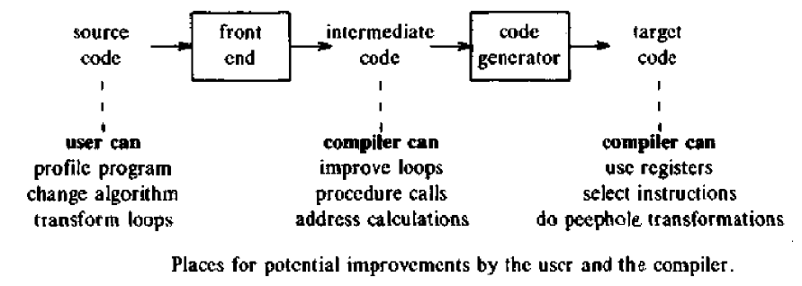
Code Optimization
The code optimization in the synthesis phase is a program transformation technique, which tries to improve the intermediate code by making it consume fewer resources (i.e. CPU, Memory) so that faster-running machine code will result.
SCS1303-Compiler Design

Slide 3
Efforts for an optimized code can be made at various levels of compiling the process:
  At the beginning, users can change/rearrange the code or use better algorithms to write the code.
  After generating intermediate code, the compiler can modify the intermediate code by address calculations and improving loops.
  While producing the target machine code, the compiler can make use of memory hierarchy and CPU registers.
SCS1303-Compiler Design

Slide 4
Optimization is a program transformation technique, which tries to improve the code by making it consume less resources (i.e. CPU, Memory) and deliver high speed.
In optimization, high-level general programming constructs are replaced by very efficient low-level programming codes.
A code optimizing process must follow the three rules given below:
  The output code must not, in any way, change the meaning of the program.
  Optimization should increase the speed of the program and if possible, the program should demand less number of resources.
  Optimization should itself be fast and should not delay the overall compiling process.
SCS1303-Compiler Design

Slide 5
Why Optimize?
Optimizing an algorithm is beyond the scope of the code optimization phase. So the program is optimized.
It may involve reducing the size of the code. So optimization helps to:
  Reduce the space consumed and increases the speed of compilation.
  Manually analyzing datasets involves a lot of time. Hence we make use of software like Tableau for data analysis. Similarly manually performing the optimization is also tedious and is better done using a code optimizer.
  An optimized code often promotes re-usability.
SCS1303-Compiler Design

Slide 6
Types of Code Optimization
The optimization process can be broadly classified into two types :
Machine Independent Optimization:
  Attempts to improve the intermediate code to get a better target code as the output.
  The part of the intermediate code which is transformed here does not involve any CPU registers or absolute memory locations.
Machine Dependent Optimization:
  Done after the target code has been generated and when the code is transformed according to the target machine architecture.
  It involves CPU registers and may have absolute memory references rather than relative references.
  Machine-dependent optimizers put efforts to take maximum advantage of the memory hierarchy.
SCS1303-Compiler Design

Slide 7
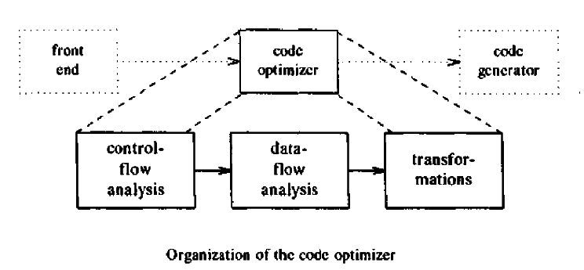
The techniques used are a combination of Control-Flow and Data-Flow analysis.
Control-Flow Analysis: Identifies loops in the flow graph of a program since such loops are usually good candidates for improvement.
Data-Flow Analysis: Collects information about the way variables are used in a program.
SCS1303-Compiler Design

Slide 8
Principle sources of Optimization
There are generally two phases of optimization:
Global Optimization:
Transformations are applied to large program segments that includes functions, procedures and loops.
2. Local Optimization:
Transformations are applied to small blocks of statements. The local optimization is done prior to global optimization.
SCS1303-Compiler Design

Slide 9
Major Topics to be covered
Local optimization
  Performed within a straight line block of code(a block with no jumps in except at the beginning and no jumps out except at the end)
  Peephole optimization
Loop optimization
Data flow analysis
  The transformation of useful relationships from all parts of the program to the places where information can be of use.
SCS1303-Compiler Design

Slide 10
LOCAL OPTIMIZATION
SCS1303-Compiler Design

Slide 11
Function Preserving Transformations
There are number ways in which the compiler can improve a program without changing the function it computes.
  Common sub expression elimination
  Copy propagation
  Dead-code elimination
  Constant folding
SCS1303-Compiler Design

Slide 12
Common sub expression elimination
Consider the sequence of code:
  a=b+c
  b=a-d
  c=b+c
  d=a-d
  After eliminating the common subexpression:
  a=b+c
  b=a-d
  c=b+c
  d=b
SCS1303-Compiler Design

Slide 13
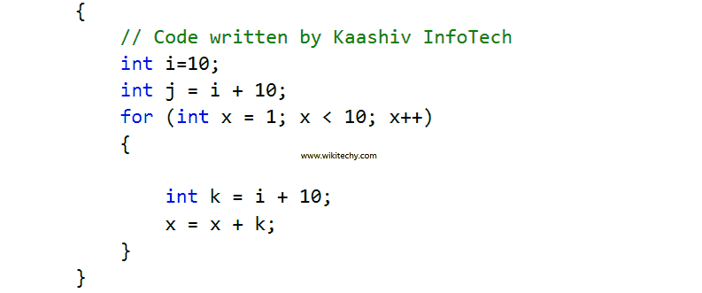
Common sub expression elimination
SCS1303-Compiler Design

Slide 14
Copy propagation
The process of replacing the occurrences of targets of direct assignments with their values. A direct assignment is an instruction of the form x = y, which simply assigns the value of y to x.
Example: Copy propagation would yield:
y = x z = 3 + x
z = 3 + y
Copy propagation often makes use of reaching definitions, use-def chains and def-use chains when computing which occurrences of the target may be safely replaced.
Copy propagation is a useful "clean up" optimization frequently used after other optimizations have already been run.
Some optimizations—such as elimination of common sub expressions require that copy propagation be run afterwards in order to achieve an increase in efficiency.
SCS1303-Compiler Design

Slide 15
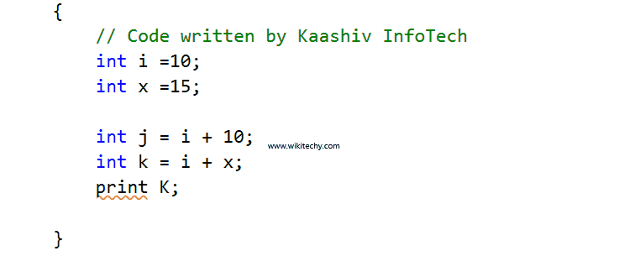
Dead code elimination
A variable is placed at a point in a program if its value can be used eventually or otherwise it is die at that point.
A related idea is dead (or useless) code statements that compute values that never get used.
SCS1303-Compiler Design

Slide 16
Constant Folding
Involves folding the constants. The expressions that contain the operands having constant values at compile time are evaluated.
Those expressions are then replaced with their respective results.
Identification of common sub expressions and replacement of run-time computation by compile-time computation.
Example:
Circumference of Circle = (22/7) x Diameter
This technique evaluates the expression 22/7 at compile time.
The expression is then replaced with its result 3.14.
This saves the time at run time.
e.g.
A[I+1]=B[I+1]
Optimized code:
J=I+1
A[J]=B[J]
SCS1303-Compiler Design

Slide 17
Loop Optimization
Loops are a very important place for optimizations particularly the inner loops where programs move to spend the bulk of their time
The running time of a program may be upgrade if we reduce the number of instructions in an inner loop , even if we increase the amount of code outside that loop.
An important changes that decreases the number of code in a loop is code motion.
90-10 Rule:
  States that 90% of the time is spent in the 10% of the code.
SCS1303-Compiler Design

Slide 18
Techniques
Code Motion
Induction variable elimination
Reduction in Strength
Loop Unrolling
Loop Fusion
SCS1303-Compiler Design

Slide 19
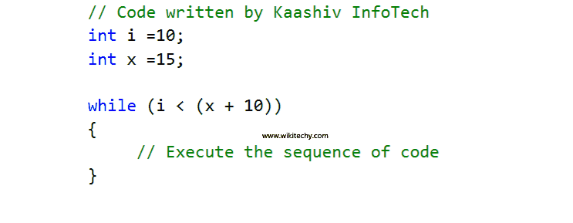
Code Motion
Reduce the evaluation frequency of expression.
Bring loop invariant statements out of the loop.
SCS1303-Compiler Design

Slide 20
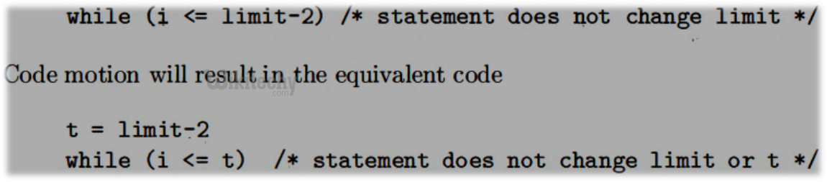
Loop invariant computation
This transformation capture expression that get the same result independent of the number of times a loop is executed (a loop-invariant computation) and calculate the expression before the loop.
Note that the motion "before the loop" assumes the existent of an entry for the loop, one basic block to which all jumps from outside the loop go.
SCS1303-Compiler Design

Slide 21
Induction Variable Elimination
An induction variable is a variable whose value on each loop iteration is a linear function of the iteration index.
When such variables and the expressions they compute are found, often the variable itself can be eliminated or a strength reduction can be performed.
Example:
J := 0
FOR I := 1 to N DO
...
J := J + 1
K := 2 * J
M := 3 * K
...
A[M] :=
ENDFOR
J, K and M are all induction variables.
Example:
I=1
T=I*4
I and T are Induction variables
Optimized code:
T=0
T=T+4
SCS1303-Compiler Design

Slide 22
Reduction in strength
Expensive operations are replaced with equivalent but less expensive operations.
The classic example of strength reduction converts "strong" multiplications inside a loop into "weaker" additions.
Examples of strength reduction include:
Replacing a multiplication within a loop with an addition
Replacing an exponentiation within a loop with a multiplication
    X=X*2 => X=X+X
    X=X**2 => X=X*X
SCS1303-Compiler Design

Slide 23
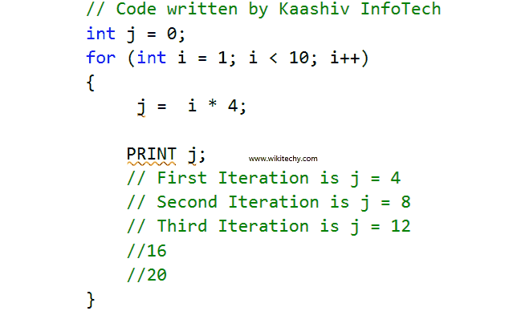
Reduction in strength
Expensive operations are replaced with equivalent but less expensive operations.
The classic example of strength reduction converts "strong" multiplications inside a loop into "weaker" additions
SCS1303-Compiler Design

Slide 24
Loop Unrolling:
e.g
int i=1;
while(i<=100)
{
a[i]=b[i];
i++;
}
Optimized as:
int i=1;
while(i<=100)
{
a[i]=b[i];
i++;
a[i]=b[i];
i++;
}
Loop Fusion:
e.g
for i=1 to n do
for j=1 to m do
a[i,j]=10
Optimized as:
for i=1 to n*m do
a[i]=10
Other Loop opt.:
Loop Fission
Loop Peeling
Loop Interchange
SCS1303-Compiler Design

Slide 25
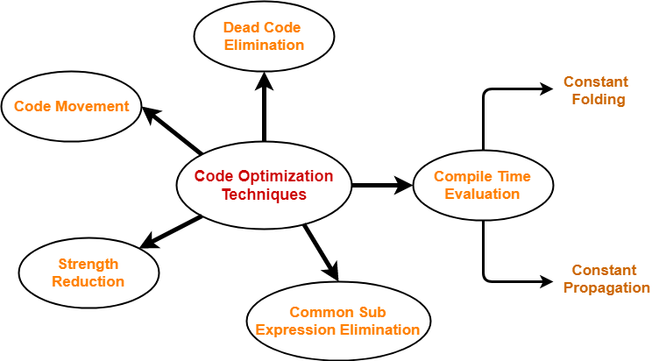
Code Optimization Techniques
SCS1303-Compiler Design

Slide 26
BASIC BLOCKS AND FLOW GRAPHS
SCS1303-Compiler Design

Slide 27
Basic Blocks and Flow Graphs
The Machine-Independent Code-Optimization phase consists of control-flow and data-flow analysis followed by the application of transformations.
During Control-Flow analysis, a program is represented as a Flow Graph where:
  Nodes represent Basic Blocks:
    Sequence of consecutive statements in which flow-of-control enters at the beginning and leaves at the end without halt or branches;
  Edges represent the flow of control.
SCS1303-Compiler Design

Slide 28
Characteristics of basic blocks
They do not contain any kind of jump statements in them.
There is no possibility of branching or getting halt in the middle.
All the statements execute in the same order they appear.
They do not lose the flow control of the program.
SCS1303-Compiler Design

Slide 29
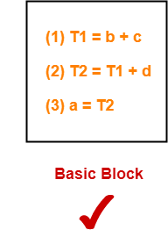
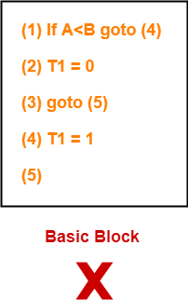
Example
Three Address Code for the expression a = b + c + d is:
  T1=b+c
  T2=T1+d
  a=T2
All the statements execute in a sequence one after the other.
Thus, they form a basic block.
Three Address Code for the expression If A<B then 1 else 0 is:
(1) If A<B goto (4)
(2) T1=0
(3) Goto (5)
(4)T1=1
(5)
The statements do not execute in a sequence one after the other.
Thus, they do not form a basic block.
SCS1303-Compiler Design

Slide 30
Basic Block Construction
Algorithm: Partition into basic blocks
Input: A sequence of three-address statements
Output: A list of basic blocks with each three-address statement in exactly one block.
Method:
1. We first determine the set of leaders, the first statements of
basic blocks. The rules we use are of the following:
a. The first statement is a leader.
b. Any statement that is the target of a conditional or
unconditional goto is a leader.
c. Any statement that immediately follows a goto or
conditional goto statement is a leader.
2. For each leader, its basic block consists of the leader and all statements up to but not including the next leader or the end of the program.
SCS1303-Compiler Design

Slide 31
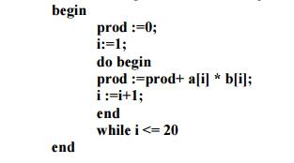
Consider the following source code for dot product of two vectors:
(1) PROD = 0
(2) I = 1
(3) T1 = 4 x I
(4) T2 = addr(A) – 4
(5) T3 = T2[T1]
(6) T4 = addr(B) – 4
(7) T5 = T4[T1]
(8) T6 = T3 * T5
(9) PROD = PROD + T6
(10) I = I + 1
(11) IF I <=20 GOTO (3)
Three address
code
SCS1303-Compiler Design

Slide 32
Solution:
PROD = 0 is a leader since first statement of the code is a leader.
T1 = 4 x I is a leader since target of the conditional goto statement is a leader.
Any statement that immediately follows a goto or conditional goto statement is a leader.
Now, the given code can be partitioned into two basic blocks as-
(1) PROD = 0
(2) I = 1
(3) T1 = 4 x I
(4) T2 = addr(A) – 4
(5) T3 = T2[T1]
(6) T4 = addr(B) – 4
(7) T5 = T4[T1]
(8) T6 = T3 * T5
(9) PROD = PROD + T6
(10) I = I + 1
(11) IF I <=20 GOTO (3)
(12) ----
B2
Leader
B1
T1 = 4 x I
T2 = addr(A) – 4
T3 = T2[T1]
T4 = addr(B) – 4
T5 = T4[T1]
T6 = T3 * T5
PROD = PROD + T6
I = I + 1
IF I <=20 GOTO (3)
Leader
PROD = 0
I = 1
Leader
SCS1303-Compiler Design

Slide 33
Flow Graphs
A flow graph is a directed graph with flow control information added to the basic blocks.
The basic blocks serve as nodes of the flow graph. The nodes of the flow graph are basic blocks. It has a distinguished initial node.
There is a directed edge from block B1 to block B2 if B2 appears immediately after B1 in the code.
SCS1303-Compiler Design

Slide 34
E.g.: Flow graph for the vector dot product is given as follows:
B1 is the initial node.
B2 immediately follows B1, so there is an edge from B1 to B2.
The target of jump from last statement of B2 is the first statement B2, so there is an edge from B2(last statement) to B2 (first statement).
B1 is the predecessor of B2, and B2 is a successor of B1.
PROD = 0
I = 1
B1
T1 = 4 * I
T2 = addr(A) – 4
T3 = T2[T1]
T4 = addr(B) – 4
T5 = T4[T1]
T6 = T3 * T5
PROD = PROD + T6
I = I + 1
IF I <=20 GOTO (3)
B2
---
---
SCS1303-Compiler Design

Slide 35
Transformations on Basic Blocks
A number of transformations can be applied to a basic block without modifying expressions computed by the block.
Two important classes of transformation are :
  Structure Preserving Transformations
      Common subexpression elimination
      Dead code elimination
      Renaming of temporary variables
      Interchange of two independent adjacent statements
  2. Algebraic transformation
SCS1303-Compiler Design

Slide 36
1. Structure preserving transformations:
a) Common subexpression elimination:
a : = b + c - - > a : = b + c
b : = a - d - - > b : = a - d
c : = b + c - - > c : = b + c
d : = a - d - - > d : = b
Since the second and fourth expressions compute the same expression, the basic block can be transformed as above.
b) Dead-code elimination:
Suppose x is dead, that is, never subsequently used, at the point where the statement x : = y + z appears in a basic block. Then this statement may be safely removed without changing the value of the basic block.
SCS1303-Compiler Design

Slide 37
c) Renaming temporary variables:
A statement t : = b + c ( t is a temporary ) can be changed to u : = b + c (u is a new temporary) and all uses of this instance of t can be changed to u without changing the value of the basic block. Such a block is called a normal-form block.
d) Interchange of statements:
Suppose a block has the following two adjacent statements:
t1 : = b + c
t2 : = x + y
We can interchange the two statements without affecting the value of the block if and only if neither x nor y is t1 and neither b nor c is t2.
SCS1303-Compiler Design

Slide 38
2. Algebraic transformations:
Algebraic transformations can be used to change the set of expressions computed by a basic block into an algebraically equivalent set.
Examples:
i) x : = x + 0 or x : = x * 1 can be eliminated from a basic block without changing the set of expressions it computes.
ii) The exponential statement x : = y * * 2 can be replaced by x : = y * y.
iii) x/1 = x , x/2=x*0.5
SCS1303-Compiler Design

Slide 39
Loops
A loop is a collection of nodes in a flow graph such that:
1. All nodes in the collection are strongly connected,
i.e, from any node in the loop to any other ,there is a path of length one or more ,wholly within the loop , and
2. The collection of nodes has a unique entry,
i.e, a node in the loop such that the only way to reach a node of the loop from a node outside the loop is through the entry point.
A loop that contains no other loops is called an inner loop.
SCS1303-Compiler Design

Slide 40
PROD = 0
I = 1
PROD = 0
I = 1
B1
B1
T2 = addr(A) – 4 T4 = addr(B) – 4
B3
T1 = 4 * I
T2 = addr(A) – 4
T3 = T2[T1]
T4 = addr(B) – 4
T5 = T4[T1]
T6 = T3 * T5
PROD = PROD + T6
I = I + 1
IF I <=20 GOTO (3)
After Code Motion
T1 = 4 * I
T3 = T2[T1]
T5 = T4[T1]
T6 = T3 * T5
PROD = PROD + T6
I = I + 1
IF I <=20 GOTO (3)
B2
B2
---
---
SCS1303-Compiler Design

Slide 41
PROD = 0
I = 1
B1
PROD = 0
B1
B3
T2 = addr(A) – 4 T4 = addr(B) – 4
T2 = addr(A) – 4 T4 = addr(B) – 4
B3
After Eliminating
Induction Variable
B4
T1=0
T1 = 4 * I
T3 = T2[T1]
T5 = T4[T1]
T6 = T3 * T5
PROD = PROD + T6
I = I + 1
IF I <=20 GOTO (3)
After Reduction in Strength
T1 = T1+4
T3 = T2[T1]
T5 = T4[T1]
T6 = T3 * T5
PROD = PROD + T6
IF T1 <=80 GOTO (3)
B2
B2
SCS1303-Compiler Design

Slide 42
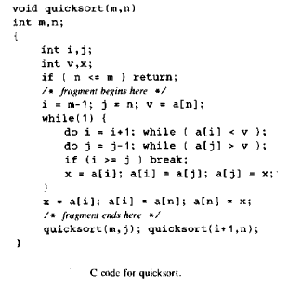
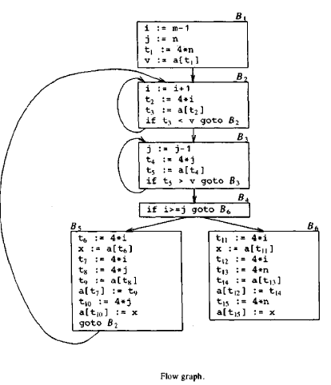
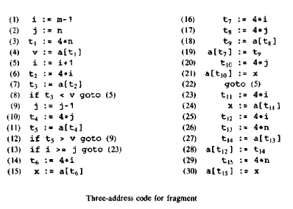
SCS1303-Compiler Design

Slide 43
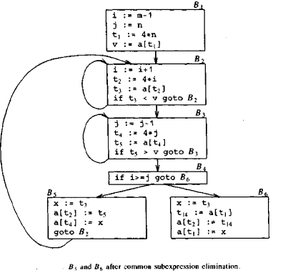
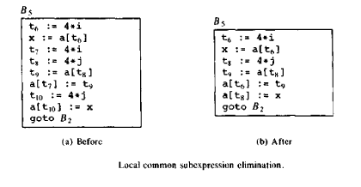
Local Optimization
Common subexpression elimination
SCS1303-Compiler Design

Slide 44



Copy propagation:
In block B5 ,
Dead code elimination:
Advantage of copy propagation is that it often turns the copy statement into dead code.
SCS1303-Compiler Design

Slide 45
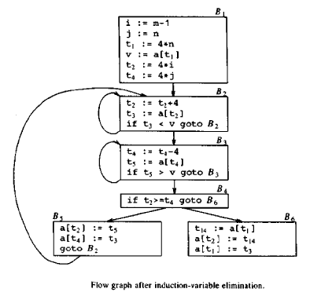
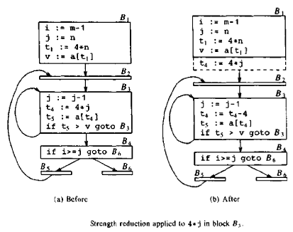
Loop Optimization
Code motion not applicable in this example.
SCS1303-Compiler Design

Slide 46
DAG representation for basic blocks
A DAG for basic block is a Directed Acyclic Graph with the following labels on nodes:
  The leaves of graph are labeled by unique identifier and that identifier can be variable names or constants.
  Interior nodes of the graph is labeled by an operator symbol.
  Nodes are also given a sequence of identifiers for labels to store the computed value.
It does not contain any cycles in it, hence called Acyclic.
SCS1303-Compiler Design

Slide 47
Optimization Of Basic Blocks
DAGs are a type of data structure. It is used to implement transformations on basic blocks.
A DAG is constructed for optimizing the basic block.
A DAG is usually constructed using Three Address Code.
DAG provides a good way to determine the common sub-expression.
It gives a picture representation of how the value computed by the statement is used in subsequent statements.
SCS1303-Compiler Design

Slide 48
Applications
DAGs are used for the following purposes:
To determine the expressions which have been computed more than once (called common sub-expressions).
To determine the names whose computation has been done outside the block but used inside the block.
To determine the statements of the block whose computed value can be made available outside the block.
To simplify the list of Quadruples by not executing the assignment instructions x:=y unless they are necessary and eliminating the common sub-expressions.
SCS1303-Compiler Design

Slide 49
Algorithm for construction of DAG
Input: A basic block
Output: It contains the following information:
  Each node contains a label. For leaves, the label is an identifier/constant.
  Each node contains a list of attached identifiers to hold the computed values.
  Consider the following formats of three-address:
    Case (i) x:= y op z
    Case (ii) x:= op y
    Case (iii) x:= y
SCS1303-Compiler Design

Slide 50
Method:
Step 1:
If y operand is undefined then create node(y).
If z operand is undefined then for case(i) create node(z).
Step 2:
For case(i), create node(op) whose right child is node(z) and left child is node(y).
For case(ii), check whether there is node(op) with one child node(y).
For case(iii), node x will be node(y).
SCS1303-Compiler Design

Slide 51
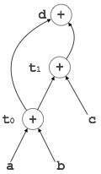

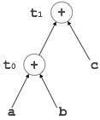
Example-1
Consider the three address code:
t₀ = a + b
t₁ = t₀ + c
d = t₀ + t₁
SCS1303-Compiler Design

Slide 52
Example-2
Consider the following block and construct a DAG for it:
(1) a = b* c
(2) d = b
(3) e = d * c
(4) b = e
(5) f = b + c
(6) g = f + d
Directed Acyclic Graph for the given block is:
SCS1303-Compiler Design

Slide 53
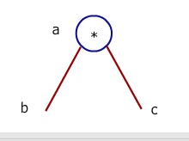
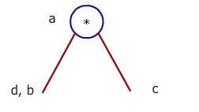
Step 1
Consider the first statement, i.e., a = b * c.
Create a leaf node with label b and c as left and right child respectively and parent of it will be *.
Append resultant variable a to the node *.
Step 2
For second statement, i.e., d = b, node b is already created.
So, append d to this node.
SCS1303-Compiler Design

Slide 54
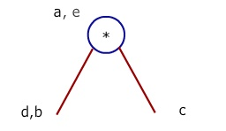
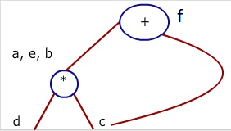
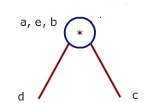
Step 3
For third statement e = d * c, the nodes for d, c and * are already created.
Node e is not created, so append node e to node *.
Step 4
For fourth statement b = e, append b to node e.
Step 5
For fifth statement f = b + c.
create a node for operator + whose left child b and right child c and append f to newly created node +.
SCS1303-Compiler Design

Slide 55
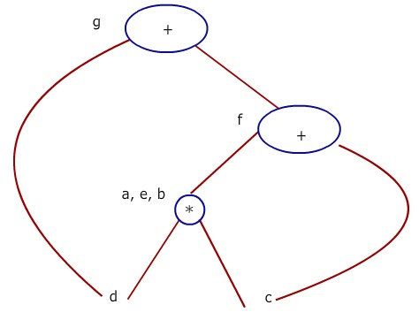
Step 6
For last statement g = f + d, create a node for operator + whose left child d and right child f and append g to newly created node +.
SCS1303-Compiler Design

Slide 56
Now, the optimized block can be generated by traversing the DAG.
The common sub-expression e = d * c which is actually b * c (since d = b) is eliminated.
The dead code b = e is eliminated.
(1) a = b* c
(2) d = b
(3) e = d * c
(4) b = e
(5) f = b + c
(6) g = f + d
(1) a = b * c
(2) d = b
(3) f = a + c
(4) g = f + d
Optimized code
SCS1303-Compiler Design

Slide 57
Example:
Consider the following three address statement in Basic Block B2:
  S1:= 4 * I
  S2:= a[S1]
  S3:= 4 * I
  S4:= b[S3]
  S5:= S2 * S4
  S6:= prod + S5
  prod:= S6
  S7:= I+1
  I := S7
  if I <= 20 goto (1)
SCS1303-Compiler Design

Slide 58
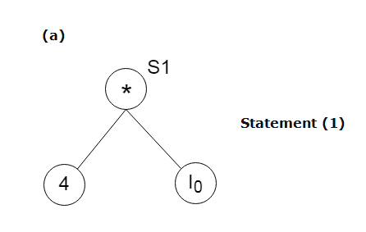
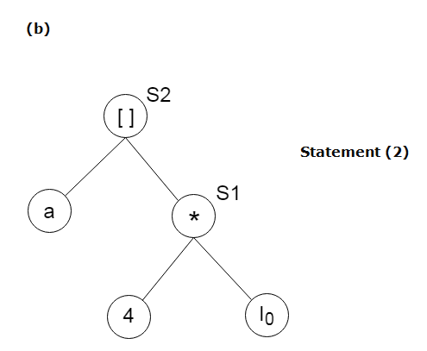
Stages in DAG Construction:
  (1) S1:= 4 * I
  (2) S2:= a[S1]
  (3) S3:= 4 * I
  (4) S4:= b[S3]
  (5) S5:= S2 * S4
  (6) S6:= prod + S5
  (7) prod:= S6
  (8) S7:= I+1
  (9) I := S7
  (10)if I<= 20 goto (1)
SCS1303-Compiler Design

Slide 59
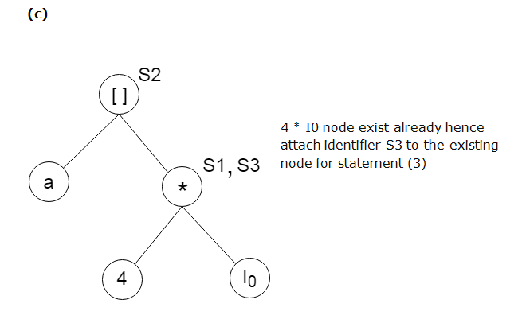
Stages in DAG Construction:
  (1) S1:= 4 * I
  (2) S2:= a[S1]
  (3) S3:= 4 * I
  (4) S4:= b[S3]
  (5) S5:= S2 * S4
  (6) S6:= prod + S5
  (7) prod:= S6
  (8) S7:= I+1
  (9) I := S7
  (10)if I<= 20 goto (1)
SCS1303-Compiler Design

Slide 60
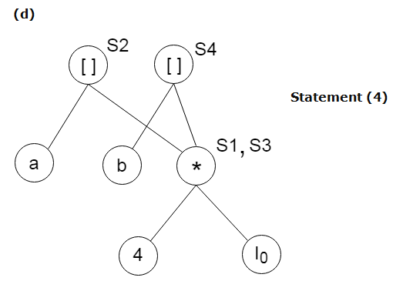
Stages in DAG Construction:
  (1) S1:= 4 * I
  (2) S2:= a[S1]
  (3) S3:= 4 * I
  (4) S4:= b[S3]
  (5) S5:= S2 * S4
  (6) S6:= prod + S5
  (7) prod:= S6
  (8) S7:= I+1
  (9) I := S7
  (10)if I<= 20 goto (1)
SCS1303-Compiler Design

Slide 61
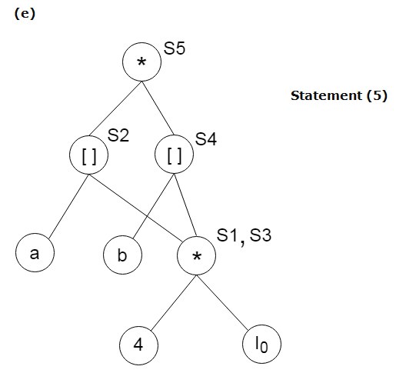
Stages in DAG Construction:
  (1) S1:= 4 * I
  (2) S2:= a[S1]
  (3) S3:= 4 * I
  (4) S4:= b[S3]
  (5) S5:= S2 * S4
  (6) S6:= prod + S5
  (7) prod:= S6
  (8) S7:= I+1
  (9) I := S7
  (10)if I<= 20 goto (1)
SCS1303-Compiler Design

Slide 62
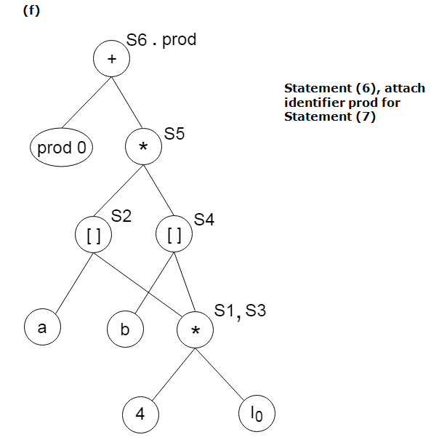
Stages in DAG Construction:
  (1) S1:= 4 * I
  (2) S2:= a[S1]
  (3) S3:= 4 * I
  (4) S4:= b[S3]
  (5) S5:= S2 * S4
  (6) S6:= prod + S5
  (7) prod:= S6
  (8) S7:= I+1
  (9) I := S7
  (10)if I<= 20 goto (1)
SCS1303-Compiler Design

Slide 63
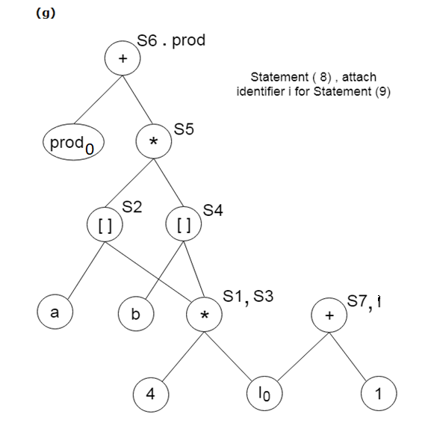
Stages in DAG Construction:
  (1) S1:= 4 * I
  (2) S2:= a[S1]
  (3) S3:= 4 * I
  (4) S4:= b[S3]
  (5) S5:= S2 * S4
  (6) S6:= prod + S5
  (7) prod:= S6
  (8) S7:= I+1
  (9) I := S7
  (10)if I<= 20 goto (1)
SCS1303-Compiler Design

Slide 64
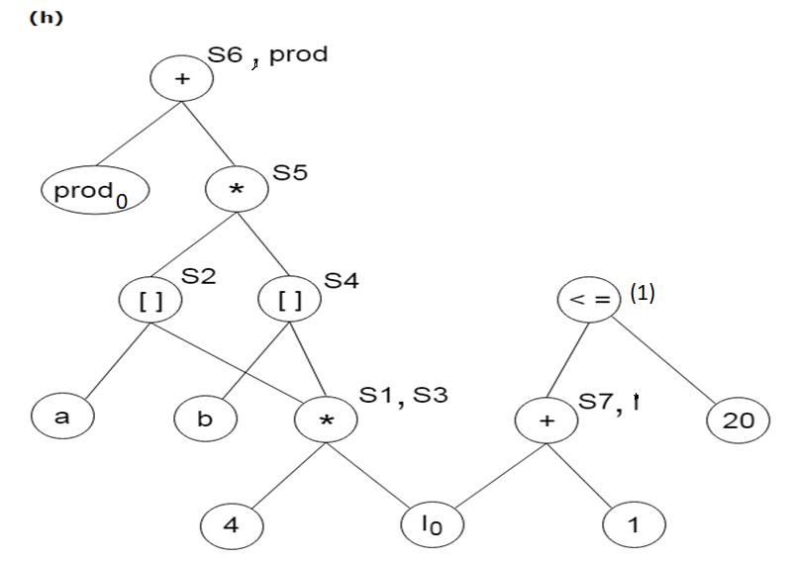
Final DAG
SCS1303-Compiler Design

Slide 65
PEEPHOLE OPTIMIZATION
SCS1303-Compiler Design

Slide 66
Peephole optimization is an optimization technique performed on a small set of compiler-generated instructions; the small set is known as the peephole or window.
Involves changing the small set of instructions to an equivalent set that has better performance.
  Instead of pushing register A onto the stack and then immediately popping the value back into register A, a peephole optimization would remove both instructions.
  Instead of adding A to A, a peephole optimization might do an arithmetic shift left.
  Instead of multiplying an index by 4, adding the result to a base address to get a pointer value, and then dereferencing the pointer, a peephole optimization may use a hardware addressing mode that accomplishes the same result with one instruction.
The term peephole optimization was introduced by William Marshall McKeeman in 1965.
SCS1303-Compiler Design

Slide 67
It basically works on the theory of replacement in which a part of code is replaced by shorter and faster code without change in output.
Peephole is the machine dependent optimization.
The objective of peephole optimization is:
  To improve performance
  To reduce memory footprint
  To reduce code size
SCS1303-Compiler Design

Slide 68
Common Techniques applied in peephole optimization:
Constant folding:
  evaluate constant sub-expression in advance
Reduction in strength:
  Replace expensive operation by cheaper ones.
Null sequences:
  delete useless operations
Combine operations:
  replace several operations with one equivalent
Algebraic laws:
  to simplify or reorder instructions
Special case instructions:
  use instructions designed for special operand cases.
Address mode operations:
  use address modes to simplify code.
SCS1303-Compiler Design

Slide 69
Peephole Optimization Techniques
Redundant-instruction elimination
Flow-of-control optimizations
Algebraic simplification
Use of machine idioms
SCS1303-Compiler Design

Slide 70
Redundant load and store elimination
The redundancy is eliminated.
Initial code:
y = x + 5;
i = y;
z = i;
w = z * 3;
Optimized code:
y = x + 5;
i = y;
w = y * 3;
Constant folding:
Initial code: x = 2 * 3;
Optimized code: x = 6;
SCS1303-Compiler Design

Slide 71
Redundant Loads And Stores:
If we see the instructions sequence
(1) MOV R0,a
(2) MOV a,R0
  we can delete instructions (2) because whenever (2) is executed, (1) will ensure that the value of a is already in register R0.
  If (2) had a label we could not be sure that (1) was always executed immediately before (2) and so we could not remove (2).
SCS1303-Compiler Design

Slide 72
Unreachable Code
An unlabeled instruction immediately following an unconditional jump can be removed.
This operation can be repeated to eliminate a sequence of instructions.
For example, for debugging purposes, a large program may have within it certain segments that are executed only if a variable debug is 1. In C, the source code might look like:
#define debug 0
….
If ( debug ) {
print debugging information
}
In the intermediate representations the if-statement may be translated as:
if debug =1 goto L1
goto L2
L1: print debugging information
L2:
SCS1303-Compiler Design

Slide 73
One obvious peephole optimization is to eliminate jumps over jumps .
Since debug is set to 0 at the beginning of the program, constant propagation can be applied:
As the argument of the first statement evaluates to a constant true,it can be replaced by goto L2.
Then all the statements that print debugging aids are unreachable and can be eliminated one at a time.
if debug =1 goto L1
goto L2
L1: print debugging information
L2:
if debug ≠1 goto L2
print debugging information
L2:
if 0 ≠1 goto L2
print debugging information
L2:
SCS1303-Compiler Design

Slide 74
Flows-of-Control Optimizations
The intermediate generation frequently produce jumps to jumps, jumps to conditional jumps, or conditional jumps to jumps.
The unnecessary jumps can be eliminated in either the intermediate code or the target code by the following types of peephole optimizations. We can replace the jump sequence
If there are no jumps to L1, then it may be possible to eliminate the statement L1:goto L2 provided it is preceded by an unconditional jump .
goto L1
….
L1: gotoL2
goto L2
….
L1: goto L2
SCS1303-Compiler Design

Slide 75
Similarly, the sequence
Finally, there is only one jump to L1 and L1 is preceded by an unconditional goto. Then the sequence can replaced by,
while the number of instructions in both is the same, we sometimes skip the unconditional jump in (2) but never in (1).Thus,(2) is superior than (1) in execution time.
if a < b goto L1
….
L1: goto L2
if a < b goto L2
….
L1: goto L2
(1)
(2)
goto L1
….
L1: if a < b goto L2
L3:
if a < b goto L2
goto L3
……
L3:
SCS1303-Compiler Design

Slide 76
Algebraic Simplification
There is no end to the amount of algebraic simplification that can be attempted through peephole optimization.
Only a few algebraic identities occur frequently enough that it is worth considering implementing them.
For example, statements such as
x := x+0
or
x := x * 1
are often produced by straightforward intermediate code-generation algorithms, and they can be eliminated easily through peephole optimization.
SCS1303-Compiler Design

Slide 77
Reduction in Strength
Reduction in strength replaces expensive operations by equivalent cheaper ones on the target machine.
Certain machine instructions are considerably cheaper than others and can often be used as special cases of more expensive operators.
For example,
  x² is invariably cheaper to implement as x*x than as a call to an exponentiation routine.
  Fixed-point multiplication or division by a power of two is cheaper to implement as a shift.
  Floating-point division by a constant can be implemented as multiplication by a constant, which may be cheaper.
SCS1303-Compiler Design

Slide 78
Use of Machine Idioms
The target machine may have hardware instructions to implement certain specific operations efficiently.
For example,
  some machines have auto-increment and auto-decrement addressing modes. These add or subtract one from an operand before or after using its value.
  The use of these modes greatly improves the quality of code when pushing or popping a stack, as in parameter passing.
  These modes can also be used in code for statements like i : =i+1.
i:=i+1 → i++
i:=i-1 → i- -
SCS1303-Compiler Design

